Slide 1
Marketing Spend Optimized by Leads
Manisha Bhattacharjee
14th July 2025

Slide 2
€2.1M bought 211k leads but..can we buy them smarter?”
2.1M
211K
99 €
Spend
Leads
CPL
303
7.1K €
Convesions
Leads
Analysis is based on Data from Oct 2024 to May 2025(1 week)
Notes:
Since Jan 2024 we spent €2.1 M and captured 211 000 leads at €99 CPL. I’ll show you which channels create the best leads, where money leaks, and how a smarter June mix cuts CPL 10 %

Slide 3
Funnel is healthy up to lead generation…then stalls
237 M
Impressions
1 M
Sessions
21 K
Leads
303
Conversions
0.14 % of the Leads are converting
Notes:
Traffic flows, leads flow, but only 0.14 % of leads convert and we will see later that each lead now costs € 115 instead of € 75 seven months ago. So,
The optimisation lever for us is lead efficiency

Slide 4
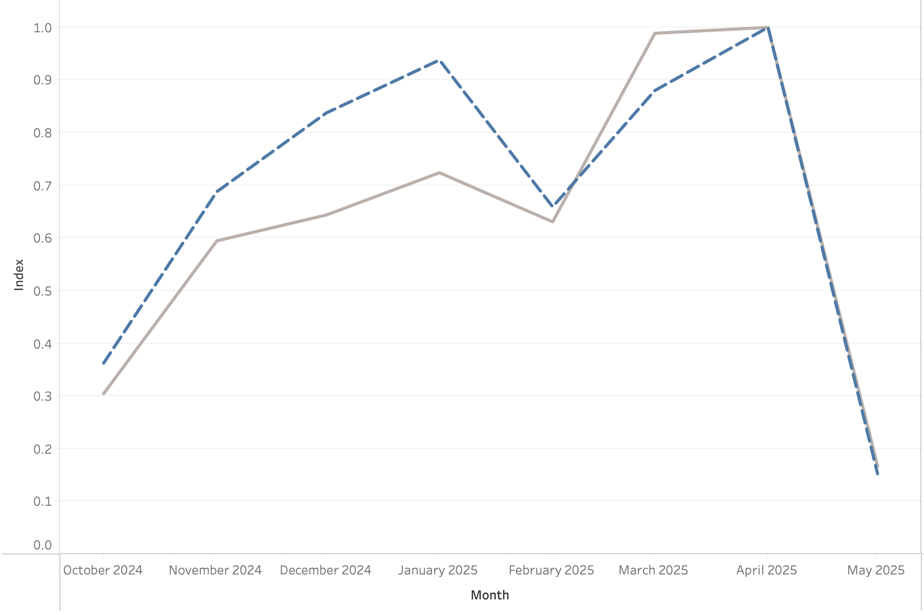
Spend grows faster than leads
Leads
Spend
Leads increased +177% in since October 2024
whereas, Spend increased
+233%
Which explains the increase in CPL
Notes:
Spend has more than doubled since October, leads are still at 1.7 times. The grey line races ahead of the navy line—that divergence explains the CPL drift.

Slide 5
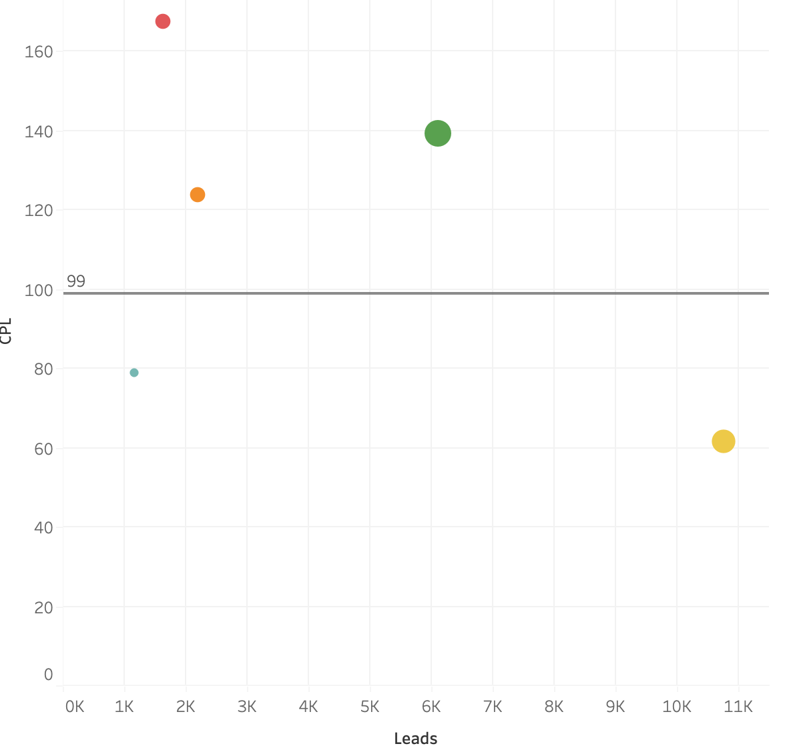
Efficient Channels vs Money Drainers
Efficient channel:
Paid Social
Native
Money Drainers:
Brand
Paid Search
Digital Video
Notes:
Two bubbles sit below the € 99 line: Paid Social (10.8 k leads at € 62 CPL) and Brand Search (2.2 k leads at € 124 but the best close-rate). Everything above the line costs more than average.

Slide 6
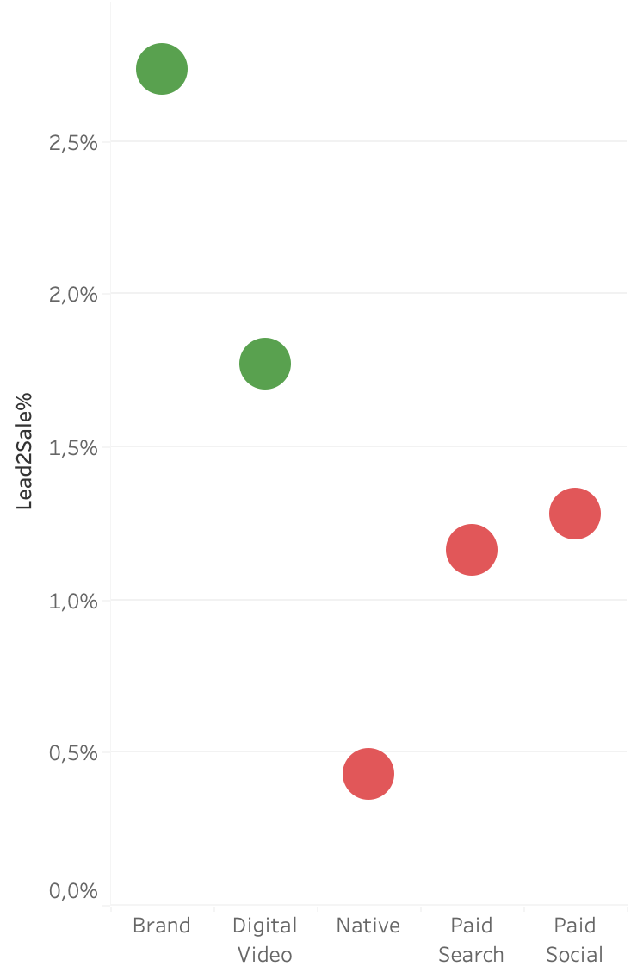
Which leads actually turn into revenue?
Brand
2.7%
Brand has the best Lead to Sales conversion.
Digital Video follows closely
Digital Video
1.8%
Paid Social
1.3%
Paid Search
1.2%
Native
0.4%
Notes:
Brand converts 2.7 % of its leads to sales, Paid Social 1.3 %. Native converts almost none-lots of ‘junk’ leads. So we scale volume where quality stays acceptable.

Slide 7
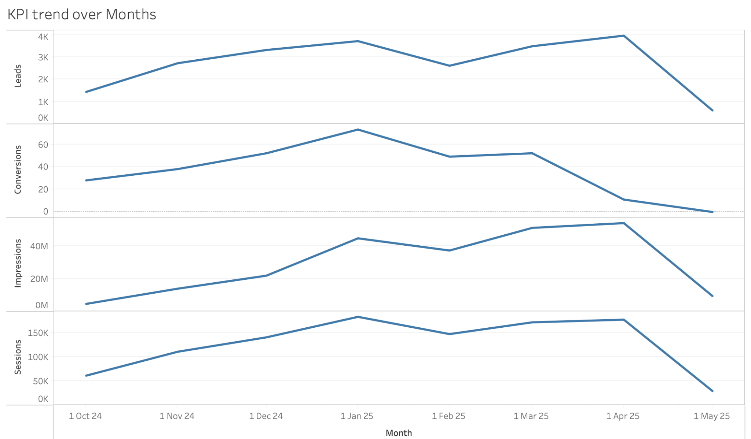
April conversion drop off
Traffic and leads are steady, drop off in conversion.
Which channel is driving it?
Notes:
Leads steady but conversions crash

Slide 8
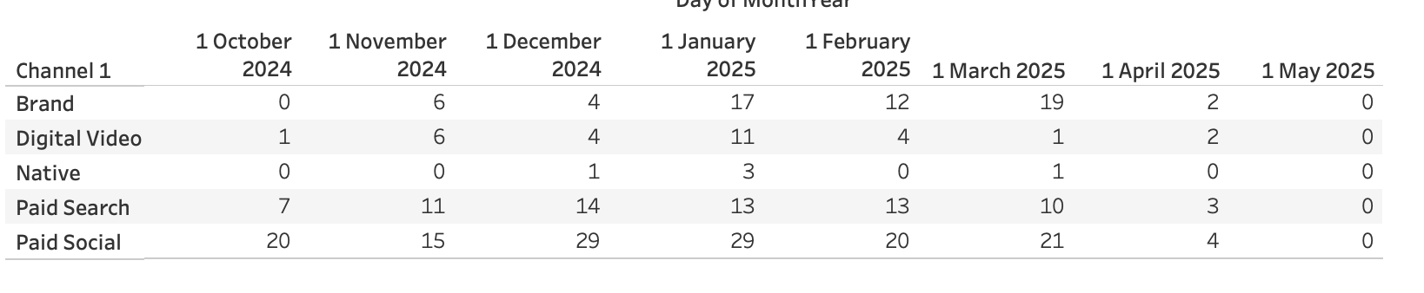
Drop off across almost all channels
Notes:
Possible Reason - Tracking error. Likely a tag-manager or CRM-sync outage from 9–24 Apr. as we saw earlier - Leads are there; only the tracking handshake is missing.

Slide 9
June Proposal : +1155 leads at € 91 CPL
Channel | Proposed Split | % of Split | Expected Leads | Expected Sales
Paid Social | 42 000 | 40 % | 682 | 9
Brand | 36 750 | 35 % | 297 | 8
Paid Search | 15 750 | 15 % | 113 | 1
Digital Video | 10 500 | 10 % | 63 | 1
Native | 3 150 | 3 % | 40 | 0
Notes:
Reallocate € 105k spend … 40 % Paid Social, 25 % Brand, trim non-brand Search, cap Video. Forecast ≈ 11 600 leads at € 9.0 CPL (down from €10)

Slide 10
Shall we go ahead and decrease our CPL with the new proposed Split?
Notes:
Same spend, € 96 k more pipeline value from extra leads. More cost win; More prospects to nurture

